Slide 1
Chongqing University of Technology
ATAI
Advanced Technique of Artificial Intelligence
Chongqing University of Technology
(ACL-2021)
code: https://github.com/pangsg/DM-GCN
Reported by Ling Zhu

Slide 2
Chongqing University of Technology
ATAI
Advanced Technique of Artificial Intelligence
Chongqing University of Technology
Motivation
Approach
Experiments
Conclusion

Slide 3
Motivation
Most recent methods adopt syntax-base Graph Neural Networks to extract the syntactic information from the dependency graph, thinking that would be beneficial for establishing relations between aspect and opinion words. However, these methods may ignore that some sentences have no remarkable syntactic structure, which causes the opposite judgement in sentiment analysis.
Notes:
Aspect:charlie sheen, sentiment polarity: negative

Slide 4
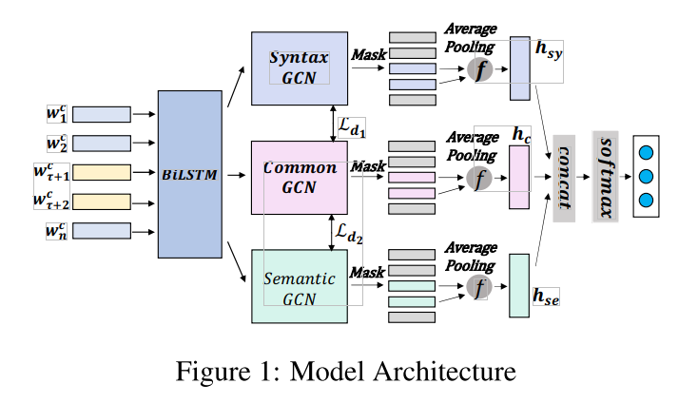
Approach
$|V|$ is the lexicon size and $d_{e} is the dimension of$
$word embedding$
Notes:
Grid Tagging Schema
2020-EMNLP-Grid Tagging Scheme for Aspect-oriented Fine-grained Opinion Extraction

Slide 5
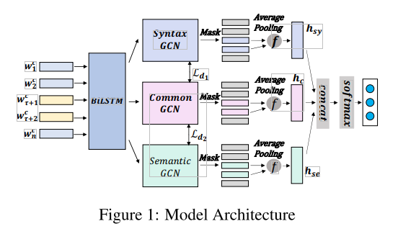
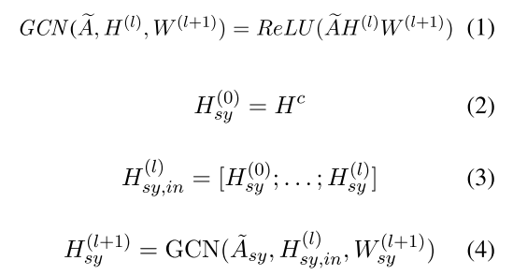
Approach
Syntactic Graph Convolution Module
$$A_{sy} is the adjacency matrix of the graph$$
$$and H^{c} is the feature matrix.$$
$d_{gcn}$ is the dimension of the GCN layer output

Slide 6
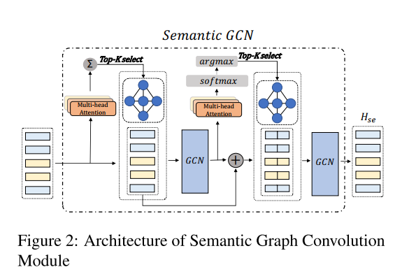
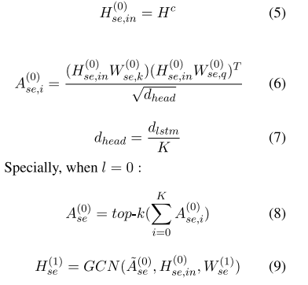
Approach
Semantic Graph Convolution Module
K is the number of heads
$d_{head}$ is the dimension of each attention head,
Notes:
K is the number of heads

Slide 7
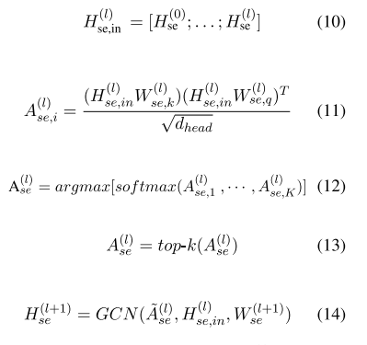
Approach
Semantic Graph Convolution Module

Slide 8
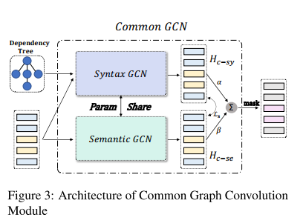
Approach
Common Convolution Module

Slide 9
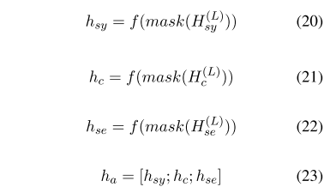
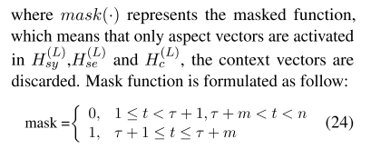
Approach
Feature fusion
f(.) is the average pooling function

Slide 10
Approach
Model Training

Slide 11
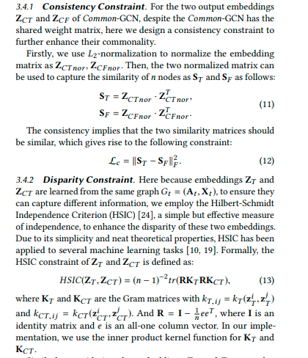
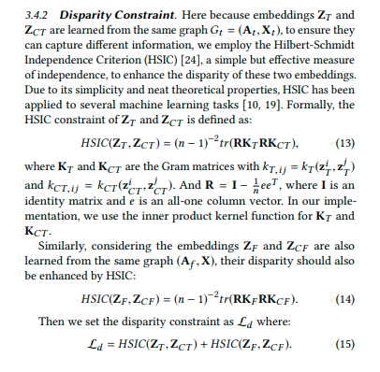

Slide 12
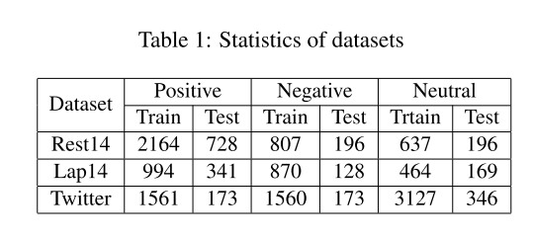
Experiments

Slide 13
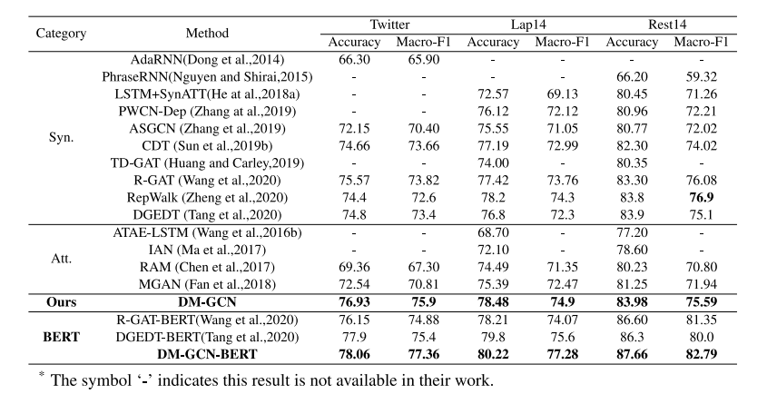
Experiments

Slide 14
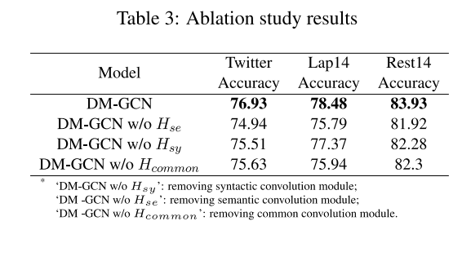
Experiments

Slide 15
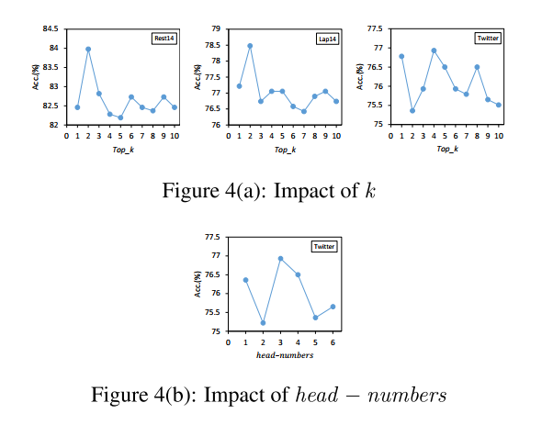
Experiments

Slide 16
Experiments

Slide 17
Thanks

